Slide 1
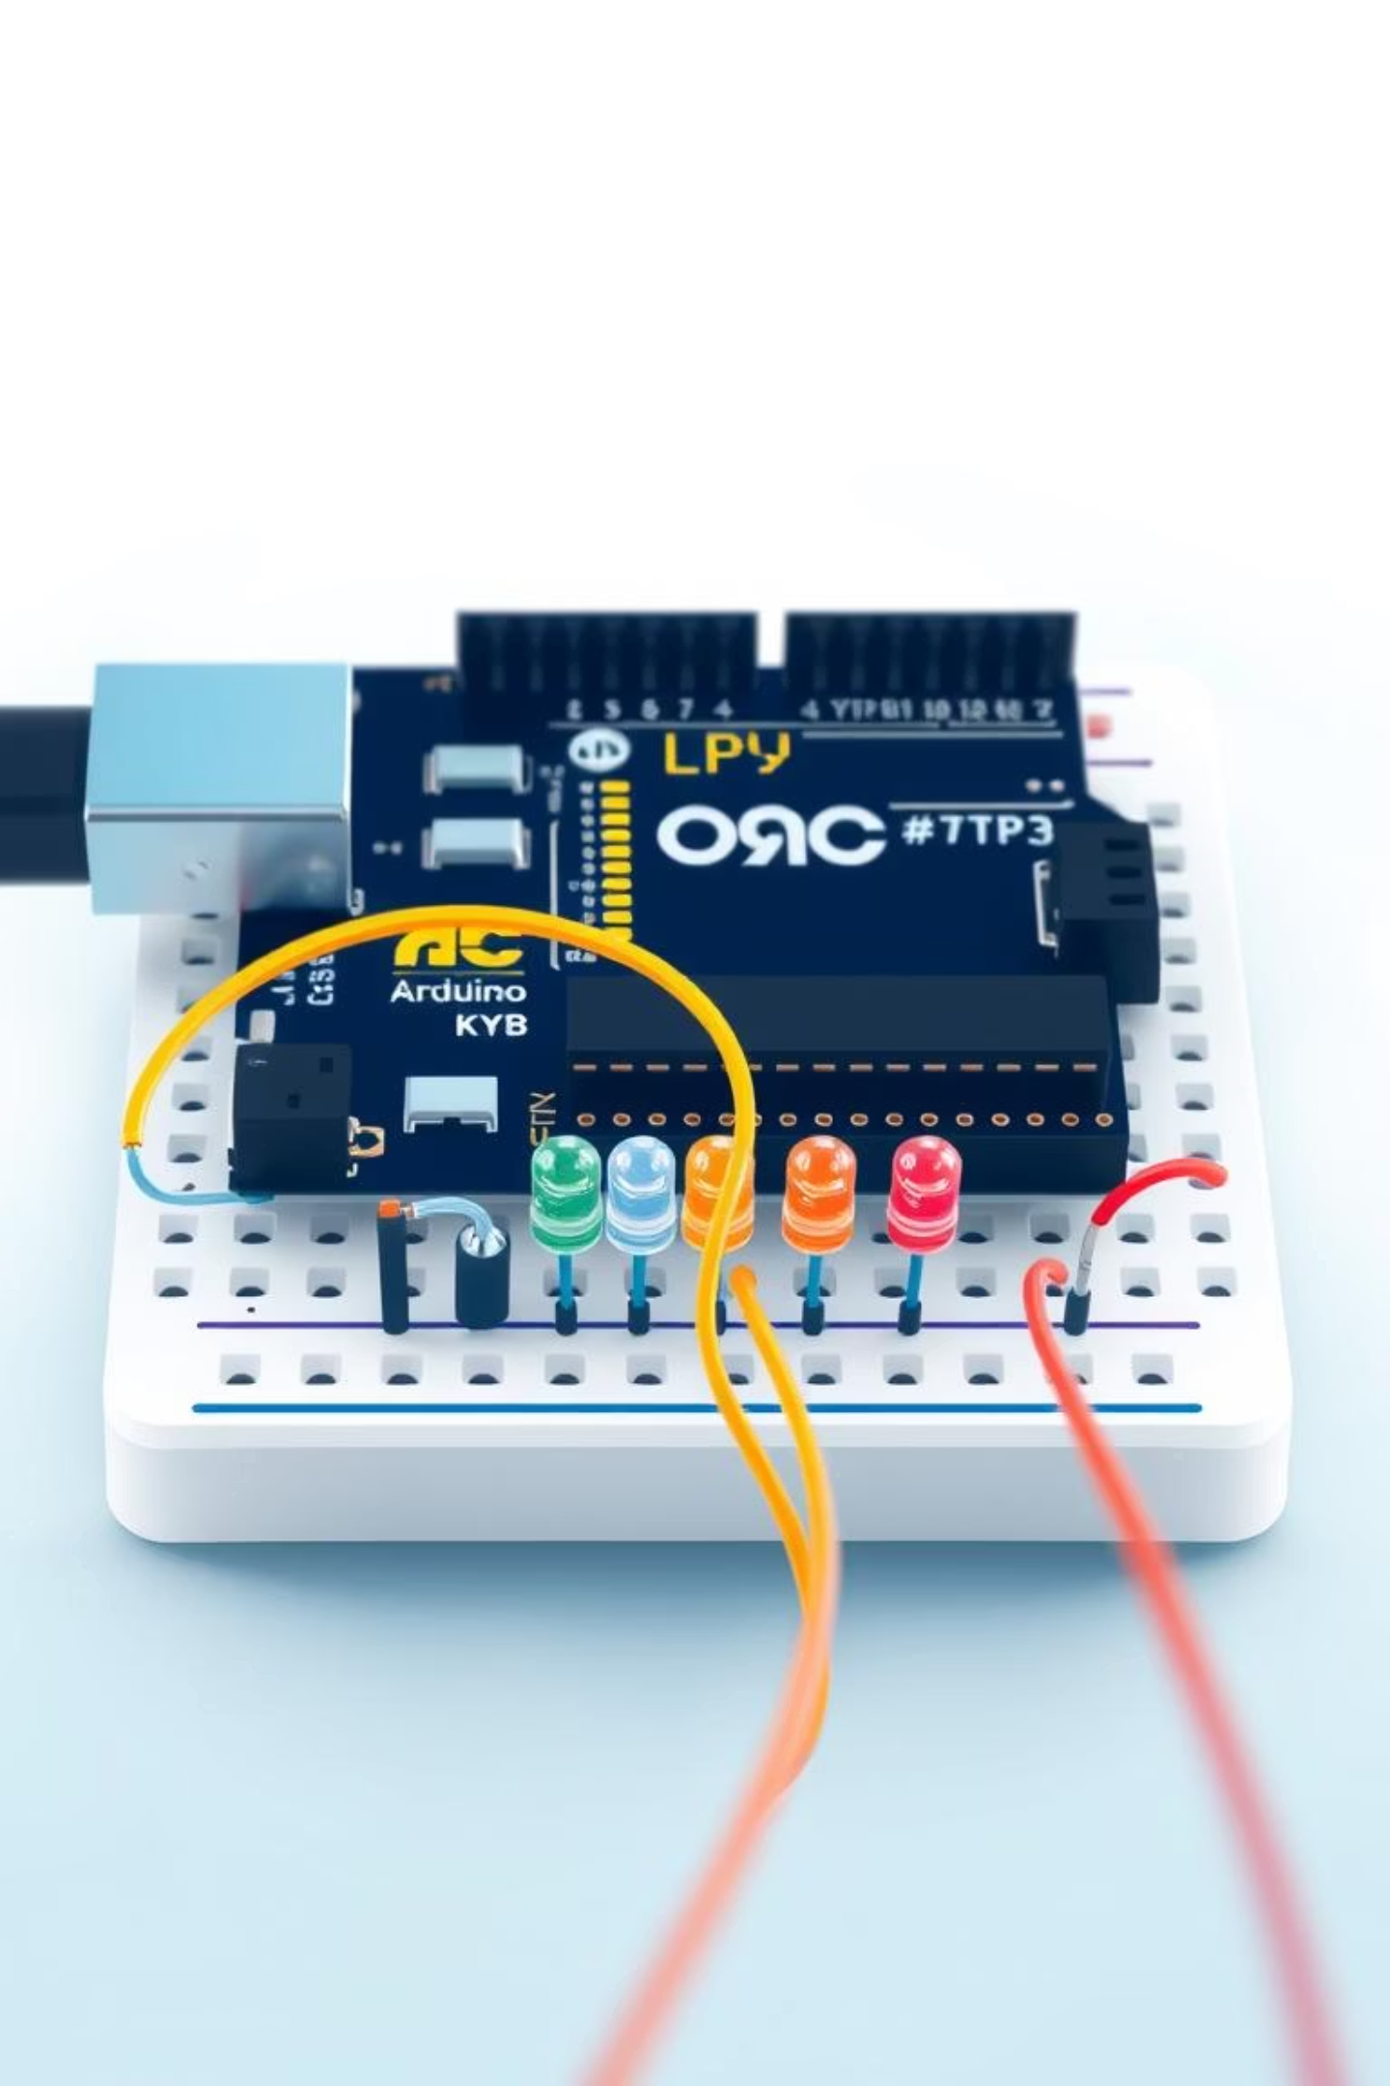
Clap Switch LED Circuit using Arduino Nano
A Sound-Activated Light Control System
Hello everyone! Our project transforms simple claps into LED toggles using an Arduino. It's a foundational step into smart automation.

Slide 2
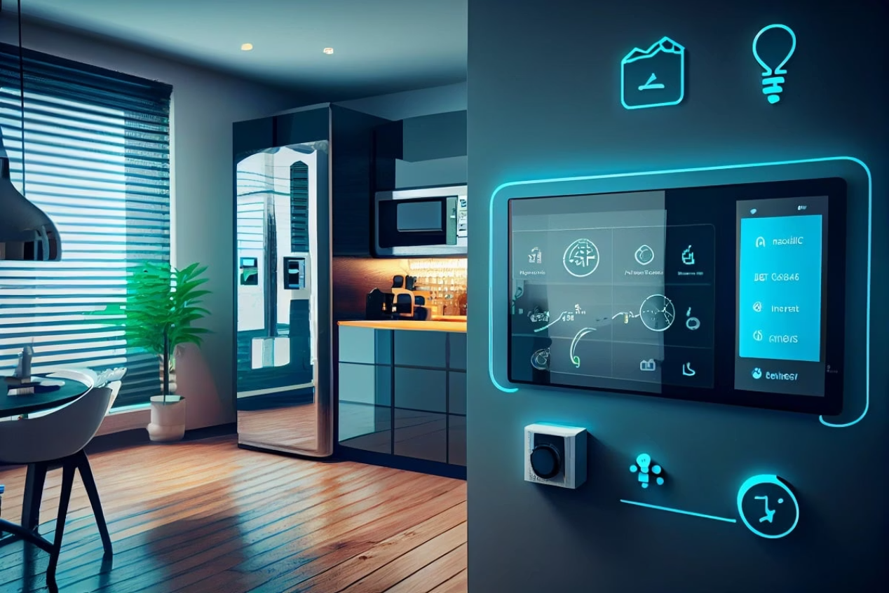
Why We Did This
Our primary goal was to create an intuitive system where sound input directly controls lighting. This project served as an excellent hands-on opportunity to dive into the fundamentals of sensor integration, Arduino programming, and basic automation principles.
This simple concept has a wide range of real-world applications:
Home Automation: Simple, touchless control for lights or small appliances.
Accessibility Tools: Providing an alternative control method for those with limited mobility.
Educational Gadgets: A fun, interactive way to learn about electronics and programming.

Slide 3
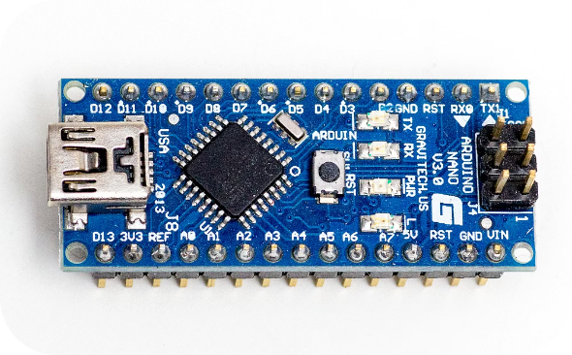
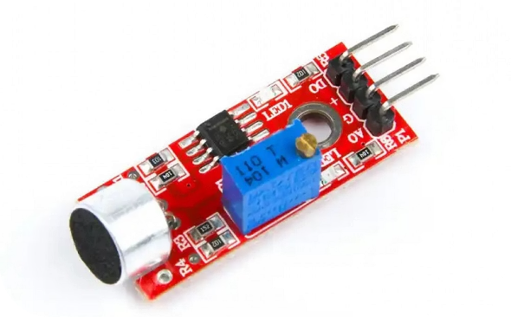
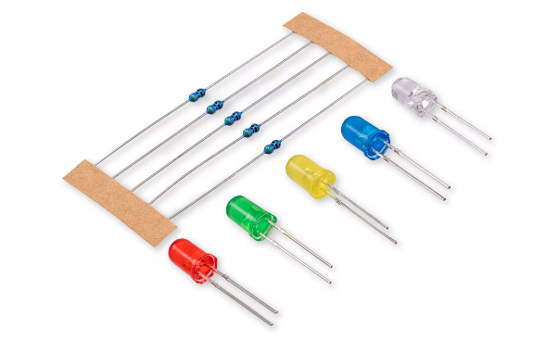
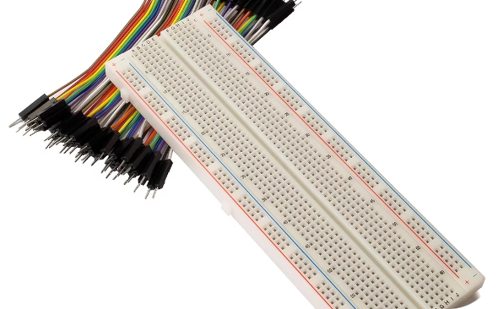

What We Used
Arduino Nano
KY-038 Sound Sensor
LEDs & Resistors
The brain of our circuit, processing sound input and controlling LEDs. Its compact size is ideal for small projects.
This module detects sound levels and converts them into a digital signal for the Arduino. It's highly sensitive, allowing for clap detection.
Three Light Emitting Diodes serve as our visual output. The 220Ω resistors protect the LEDs from excessive current.
Breadboard & Wires
Batteries & Switch
A solderless breadboard for easy prototyping, and jumper wires to connect all components reliably.
4x AA batteries in a holder with a single on/off switch for the portability of the project.

Slide 4
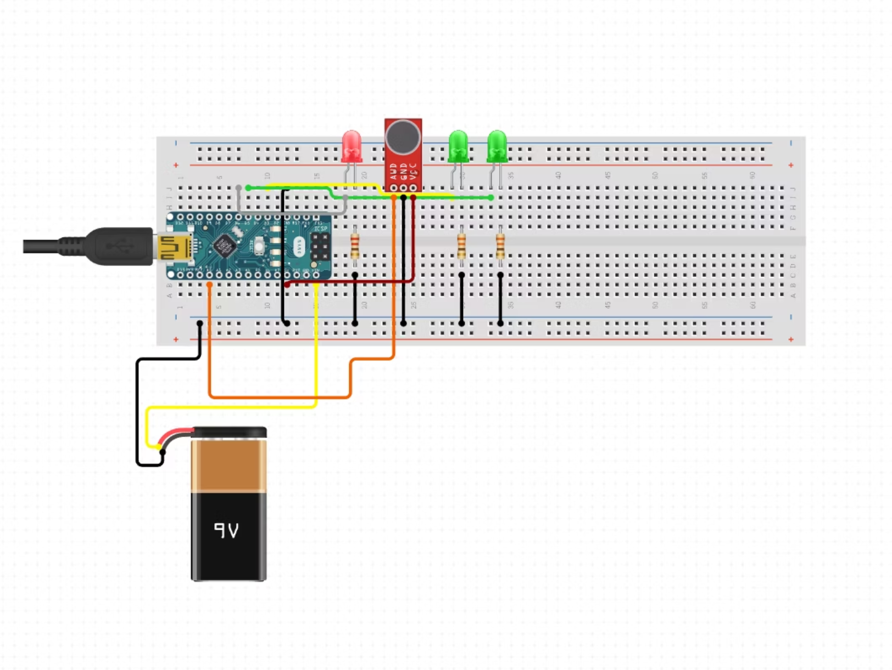
How It’s Connected
The heart of our circuit connection involves the KY-038 Sound Sensor’s digital output pin connected to Arduino Nano’s Digital Pin 2 (D2). This pin is configured to read the HIGH or LOW state from the sensor.
For visual feedback, three LEDs are connected to Arduino’s Digital Pins 3 and 6. Each LED has a 220Ω resistor in series to limit the current and prevent them from burning out. The entire setup is powered by a battery holder, providing a portable power source, with a switch to easily toggle the circuit on or off.

Slide 5




The Core Logic
Clap Sound Detection
A sudden, sharp increase in sound pressure from a clap triggers the KY-038 sound sensor.
Signal Conversion
The KY-038 converts this analog sound wave into a distinct digital signal (HIGH or LOW) that the Arduino can interpret.
Arduino Processing
The Arduino continuously monitors this digital signal, employing debounce logic to filter out spurious noise and identify a legitimate "clap" event.
LED Toggle Action
Upon detecting a valid clap, the Arduino toggles the state of the LEDs – turning them ON if they were OFF, and OFF if they were ON.

Slide 6
Arduino Logic Flow
The Arduino's programming follows a precise sequence to ensure accurate detection and control.
2
1
Monitor Sensor
Initialize System
Continuously read the digital state of the sound sensor pin. Wait for a HIGH signal, indicating detected sound.
Set up LED pins as OUTPUT, sound sensor pin as INPUT, and initialize LED state (e.g., all OFF).
4
3
Validate & Toggle
Debounce Check
If the debounce check passes (i.e., it's a valid new clap), execute the toggleLEDs() function to change the state of the LEDs. Update lastClapTime to the current time.
Once a HIGH signal is detected, record the current time using millis(). Compare it with the lastClapTime to ensure enough time (debounceDelay) has passed since the last valid clap. This prevents multiple triggers from a single clap.

Slide 7
Code in Action
This snippet demonstrates the core logic for detecting a clap and ensuring it's not a false positive due to rapid noise or sensor chatter.
if (digitalRead(soundPin) == HIGH) {
if (millis() - lastClapTime > debounceDelay) {
toggleLEDs();
lastClapTime = millis();
}
}
Key concepts at play here:
digitalRead(soundPin): This function reads the state of the sound sensor pin. When a sound above the threshold is detected, it returns HIGH.
millis(): Arduino's built-in function that returns the number of milliseconds since the Arduino board began running the current program. It's crucial for implementing debounce timing, preventing multiple triggers from a single clap.
Toggle LEDs using state tracking: The toggleLEDs() function (not shown here) would contain the logic to switch the state of the LEDs (ON to OFF, or OFF to ON) by keeping track of their current state.

Slide 8
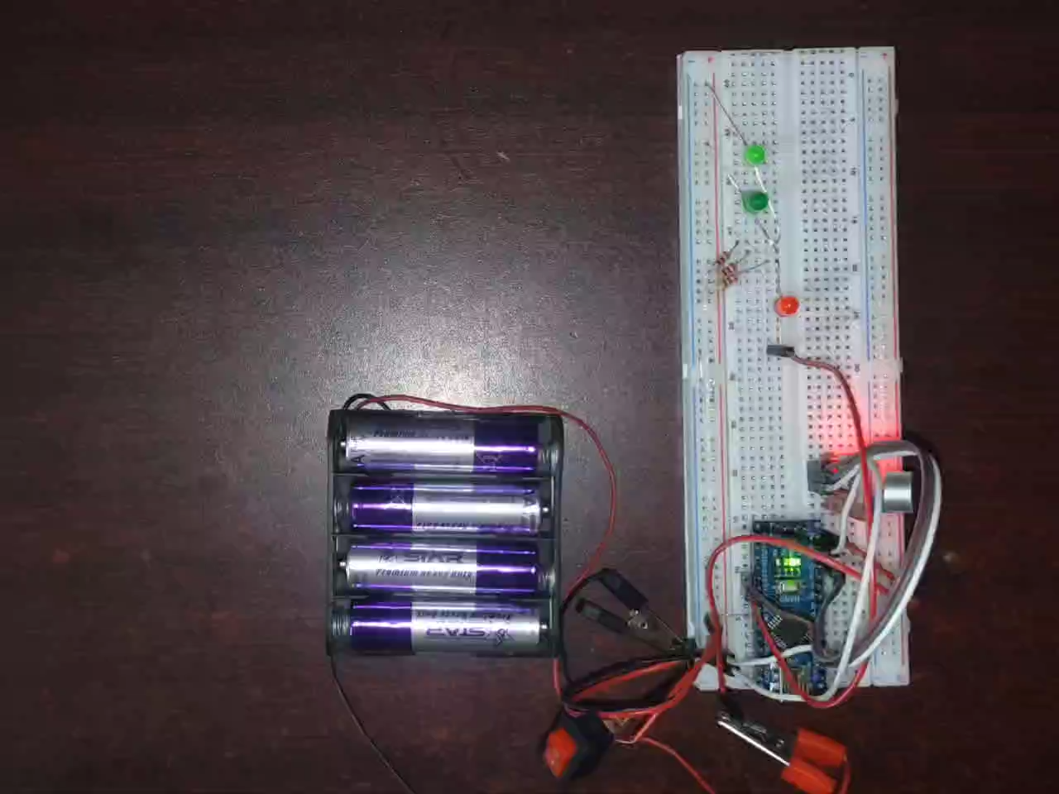
Here’s It in Action
Witness the sound-activated circuit in real-time.
Single Clap ->
Green LED On/Off
Triple Clap ->
Red LED On/Off
Optimal performance is achieved in a quiet environment, minimizing interference from background noise.
We calibrated the KY-038 sensor to be sensitive enough to distinct claps but robust enough to ignore ambient noise.
This fine-tuning of timing and sensitivity was crucial for reliable operation.

Slide 9
What We Faced & Learned
Challenges We Encountered
Key Learnings
Sensor Sensitivity: The KY-038 proved very sensitive, often picking up ambient noise, leading to false triggers.
Circuit Debugging: Gained practical experience in identifying and resolving wiring and component issues.
Debounce Timing: Fine-tuning the debounce delay was critical to distinguish between a single clap and prolonged sounds or echoes.
Code Optimization: Learned to write more robust code, particularly for timing and state management.
Hardware-Software Integration: Understanding how to effectively interface physical components with code for desired functionality.
Environmental Noise: In louder environments, random triggers were common, requiring careful adjustment of the sensor's threshold.

Slide 10
Wrapping Up
This project was a concise yet comprehensive journey into basic electronics and Arduino programming, offering a tangible demonstration of how sound can control electrical systems.
1
2
Project Summary
Future Ideas
We successfully built a basic automation system responsive to sound input, providing hands-on experience with Arduino and real-time input logic.
Expand the project by adding a relay for controlling real AC appliances, implementing more complex sound patterns (e.g., double-claps), or integrating Bluetooth/Wi-Fi for remote control capabilities.

Slide 11
Any Question?

